Slide 1
Deformable Materials: In Class Activity
BIME-200
Dr. Travis Meyer
3/26/2026

Slide 2
Learning Objectives
Conduct simple tension tests and convert data to stress-vs-strain
Visualize and analyze biomechanical data to draw inferences/conclusions about material properties (Stiffness/Young’s Modulus)
Explain how stress-strain curves are used to normalize data to different sample geometries and evaluate material properties independently.

Slide 3

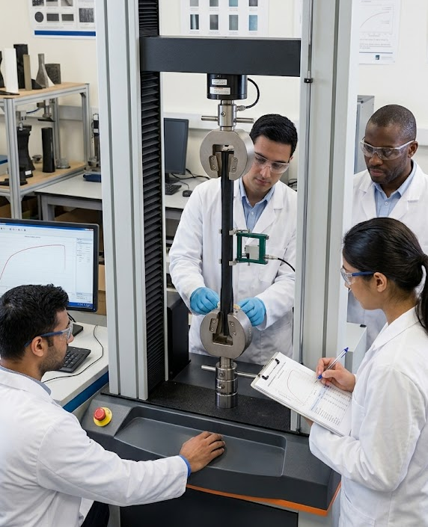
Scenario
You are a team of engineers working at an orthotics company. One of the primary raw materials for a new body-weight powered supportive boot are a series of flexible, elastic rubber rods.
Someone in purchasing messed up, and accidentally ordered the wrong kind of rubber for one of the rod dimensions, but no one can remember which one is the mistake
It is your team’s job to conduct a test to identify which of the 3 rubber rods samples is made from a different material than the other 2

Slide 4
In-Class Exercise
In Class Steps (to be completed in groups of ~3)
Come up to get supplies (3 rubber rods, weights and holder, ruler and caliper)
Pull on rods and form a hypothesis of which rod is made from a different kind of rubber
Measure starting dimensions of all 3 specimens (length and diameter/radius)
Hang weights from rod and measure change in length
  Record both mass added AND new length
  3-4 weights for each specimen
  Recommended weights are included in exercise hand-out
Measure final dimensions for all 3 specimens

Slide 5
In-Class Exercise
Out of Class Steps (to be submitted individually)
Convert mass and length to force and deformation
Plot force vs deformation curves for all 3 specimens
Convert force and deformation to stress and strain
Plot stress vs strain curves for all 3 specimens
Calculate Young’s Modulus for all 3 specimens
Answer discussion questions

